Slide 1


Test Planning and Estimation
Software Quality Assurance
Telerik Software Academy
http://academy.telerik.com
Notes:
Main sources: 1. Foundations of Software Testing ISTQB Certification - chapter 5.2 Test plans, estimates, and strategies 2. Software Testing Foundations - A Study Guide for the ISTQB Certified Tester Exam [2007]

Slide 2


The Lectors
Snejina Lazarova
Project Manager
BI & Reporting Team
Dimo Mitev
QA Architect
Backend Services Team

Slide 3

Table of Contents
Test Planning
Test Prioritization
Entry Criteria
Exit Criteria
Test Estimation
Test Strategy, Test Approach

Slide 4
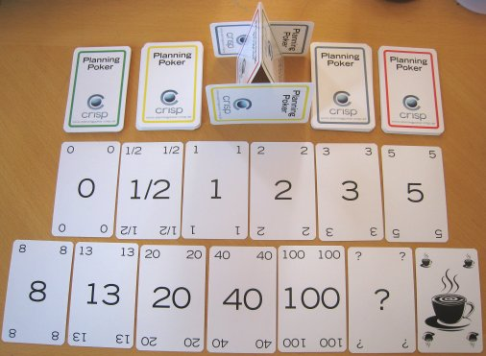
Test Planning
Why Do We Need Test Plans and How Can We Use Them?

Slide 5

The Purpose and Substance of Test Plans
Why Do We Need Test Plans and How Can We Use Them?

Slide 6
Why Do We Write a Test Plan?
Writing a test plan guides our thinking
If we can explain something in words, we understand it
Otherwise there is a good chance we don't
Forces us to confront the challenges that await us
Focus our thinking on important topics

Slide 7
Why Do We Write a Test Plan? (2)
Serves as a vehicle for communicating with other members of the project team
Testers, peers, managers and other stakeholders
Using a test plan draft allows team members to leave their notes
Becomes a record of previous discussions

Slide 8
Why Do We Write a Test Plan? (3)
Manage change
Written test plans give us a baseline
Against it we can measure revisions and changes made
Test plans should be updated at major milestones
Helps to keep testing aligned with project needs

Slide 9

Test Plan Vs. Test Design
Test Plan
Defines overall testing objectives and approach
Provides accurate test estimation
Test Design
Defines what will be tested
Describes expected results

Slide 10
Reasons for Planning Tests
Repeatability
All testers should be able to execute the tests
Assures all critical elements are tested correctly
Parts can be executed
Controllability
Knowledge of test data requirements, expected results, what to run
Coverage
Ensures adequate coverage
Notes:
Domain6_TestPlanning.ppt

Slide 11
Test Documentation Hierarchy
Test Plan
Direction for overall testing activity
Test Design Specification
Refines Approach, identifies features to be covered
Test Case Specification
Specific input/intended output values
Test Procedures Specification
Test execution steps
Notes:
Domain6_TestPlanning.ppt

Slide 12

Test Plan Templates
Test plans can be made using templates
E.g., IEEE 829 test plan template
Helps us remember the important challenges

Slide 13
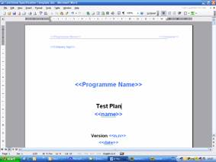

Test Plan Templates
Demo
Notes:
This demo should be used to describe the typical structure of a test plan

Slide 14
Elements of a Test Plan
Test Scope
Defines what will be tested
Test Objectives
Description of expected (measurable) test result, priority
Assumptions
Include skill level of testers, budget, starting state of application, tools & equipment availability, etc.
Risk Analysis
Things that could impact testing ability

Slide 15
Elements of a Test Plan (2)
Test Design
Identifies tests to run, stages to test, outlines sequence and timing
Roles & Responsibilities
Test Schedule & Resources
Major test activities, sequence of tests, estimates, dependence on other activities, people, tools, facilities
Test Data Management
Methods for preparing test data, backup/rollback procedures, data requirements/sources, any data conditioning/conversion, data security

Slide 16
Elements of a Test Plan (3)
Test Environment
Version Control, HW/SW configurations, defect tracking tool, Environment for each kind of testing
Communication Approach
Meetings, processes, tools, techniques, contact lists
Test Tools
Automation, performance, verification, defect tracking, test planning, etc.

Slide 17

Testing Concerns
Not Enough Training
Us Versus Them Mentality
Lack of Test Tools
Lack of Management Understanding/Support
Lack of Customer and User Involvement
Not Enough Time
Over Reliance on Independent Testers
Rapid Change
Lose-Lose Situation
Having to Say “No”

Slide 18

Who? What? When? How?
Planning resources is an essential part of test planning
Often this is related to hard decisions
Consensus across the team is needed

Slide 19

What Else Is Important?
A good test plan provides some more answers:
How precisely should testing be documented
What metrics should be used
Entry criteria
Exit criteria

Slide 20

Test Planning Activities

Slide 21
Test Planning Activities (1)
Defining the overall approach to and strategy for testing
Deciding about the test environment
Definition of the test levels
How are they going to cooperate
Integrating and coordinating the testing activities with other project activities

Slide 22
Test Planning Activities (2)
Deciding how to evaluate the test results
Selecting metrics
For monitoring and controlling test work
Defining test exit criteria
Test documentation
How much documentation shall be prepared
What templates will be used

Slide 23
Test Planning Activities (3)
Writing the test plan
Deciding on what, who, when, and how much testing
Estimating test effort and test costs
(Re)estimating and (re)planning the testing tasks

Slide 24

Test Prioritization

Slide 25
Why Should We Prioritize Tests?
Time and budget are never enough
Not sufficient to execute all planned test cases
Still - as many critical faults should be found as possible
The prioritization rule:
A premature end of testing should still assure the best possible test result at that actual point in time

Slide 26
Prioritization Criteria
Criteria for prioritization of test cases may be:
Usage frequency of a function / probability of failure
Risk of failure
Visibility of a failure
Priority of the requirements
Customer priorities
Code complexity
Project risk

Slide 27

Entry Criteria
Defining When to Start Testing

Slide 28
Test Entry Criteria
Test entry criteria define when to start testing
E.g., at the beginning of a test level or when a set of tests is ready for execution
Entry criteria may cover the following:
Test environment availability and readiness
Test tool readiness in the test environment
Testable code availability
Test data availability
Notes:
ISTQB - Foundation Level Syllabus 2010

Slide 29

Exit Criteria
Defining When to Stop Testing

Slide 30

Test Exit Criteria
What is test exit criteria?
A definition of when testing can be stopped (totally or within a test level)

Slide 31
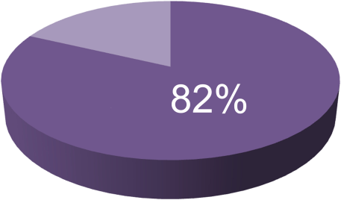

Typical Test Exit Criteria
Typically exit criteria may cover the following:
Thoroughness of measures
E.g., coverage of code, functionality or risk
Estimates of defect density or reliability measures
Cost

Slide 32

Typical Test Exit Criteria (2)
Typically exit criteria may cover the following:
Residual risks
E.g., defects not fixed
Lack of test coverage in certain areas
Schedules
E.g., time to market

Slide 33
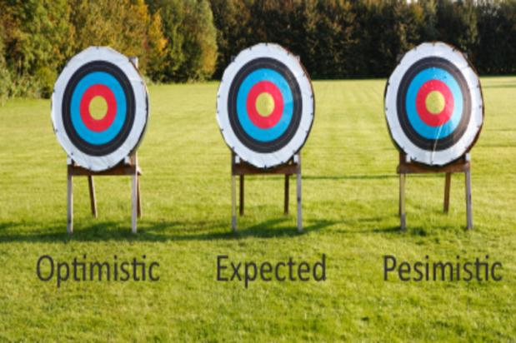
Test Estimation

Slide 34

Test Estimation
What do we estimate?
What testing will involve?
What it will cost?

Slide 35

Work-breakdown
Test estimation could start with designing a work-breakdown structure
Identifying the stages, activities and tasks for testing

Slide 36

Phases of a Test Project
A test project could be broken down into phases
Planning and control
Analysis and design
Implementation and execution
Evaluating exit criteria and reporting
Test closure

Slide 37
Activities
Within each phase we identify activities and tasks within each activity
This can be performed in two ways:
Working forward
"Now, what comes next?"
Working backward
"What activities and tasks are required in each stage to carry out this testing?"

Slide 38


Estimation Approaches
Testing effort is usually estimated using two approaches:
Metrics-based approach
Using metrics of former or similar projects
Using typical values
Expert-based approach
Consulting with experts and with people who will actually perform the testing

Slide 39

Co-ordination With the Management
Even the best estimate must be negotiated with management
Different sides on the project can have different priorities
Effective negotiations are focused on finding the best balance
Between quality,
schedule, budget and features

Slide 40
Factors Affecting Testing Effort
The testing effort may depend on a number of factors:
Complexity and size of the product
Life-cycle model used
Tools available
Product documentation available
How detailed test documentation needs to be done
Time pressure
People factors
Etc.

Slide 41

Test Strategy and Test Approach

Slide 42

Test Strategy
What is a test strategy?
Defines the project's testing objectives and the means to achieve them
Determines testing effort and costs
One of the key-responsibilities of the test manager

Slide 43

What is the Point of Test Strategies?
The main goal of the test strategy is to choose the best test approach
Optimizing the relation between costs of testing and costs of defects

Slide 44

Test Approach
What is a test approach?
Implementation of the test strategy for a specific project
The testing strategy usually involves a combination of test approaches

Slide 45
Preventative vs. Reactive Approach
Preventive approaches
Testers are involved from the beginning:
Test planning and design start as early as possible
Reactive approaches
Testers are involved (too) late and a preventive approach cannot be chosen
Test planning and design starts after the software or system has already been produced

Slide 46
Analytical vs. Heuristic Approach
Analytical approach
Based on data and (mathematical) analysis of collected data
Heuristic approach
Based on experience of experts and/or on rules of thumb
When no data are available
When mathematical modeling is too complicated
When know-how is missing

Slide 47
Other Approaches
In practice, approaches used are between the extremes of analytical and heuristic – e.g.,:
Model-based testing
Risk-based testing
Reuse-oriented approaches
Checklist-based (methodical) approaches
Expert-oriented approaches

Slide 48
Test Planning and Estimation
?
?
?
?
?
Questions?
?
?
?
?
?
?

Slide 49




Free Trainings @ Telerik Academy
C# Programming @ Telerik Academy
csharpfundamentals.telerik.com
Telerik Software Academy
academy.telerik.com
Telerik Academy @ Facebook
facebook.com/TelerikAcademy
Telerik Software Academy Forums
forums.academy.telerik.com

